Slide 1

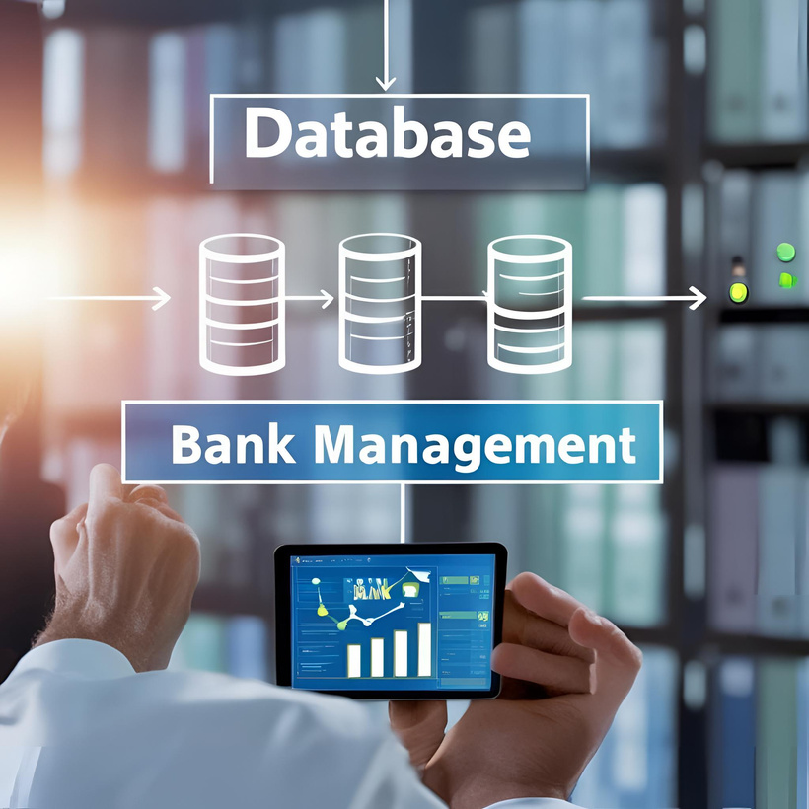
Bank Management
System
Semester Project

Slide 2
Group Members
Asaad Iqbal -> DS-4A-020
Syed Ejiz Ul Hassan-> DS-4A-025
Syed Basit Abbas->DS-4A-013 Abdul Majid->DS-4A-009

Slide 3

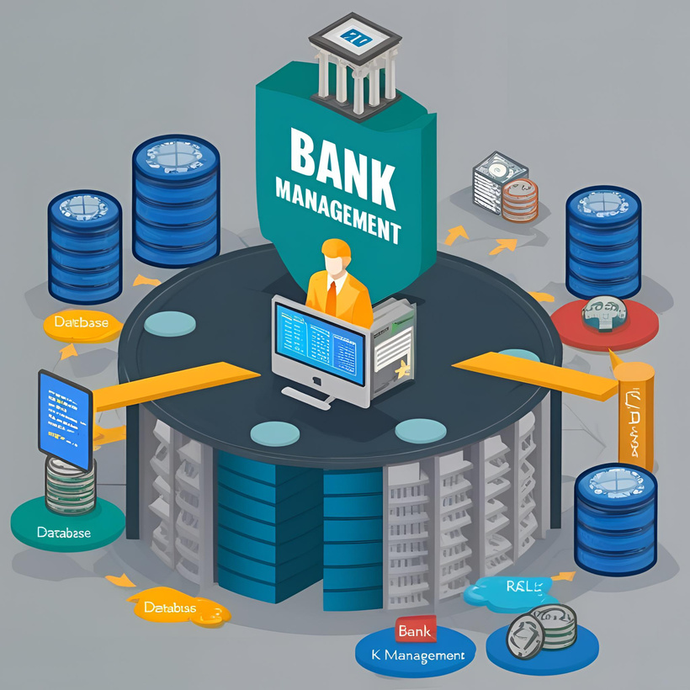
Introduction
A Bank Management System
provides an organized platform to manage customers, accounts, transactions, and loans. The purpose is to simplify banking operations and enable staff to manage customer and account data efficiently. Tools used include Python with Flask
Framework and MySQL Database.

Slide 4


Table of contents
-System Overview
-Database Design
-Stored Procedures
-Functions and Triggers
-Views
-Application Screenshots
-Challenges Faced
-Future Improvements

Slide 5

System Overview
Key Modules include:
-Login System for secure user authentication.
-Customer Management allowing for adding and viewing customers.
-Account Management for adding and viewing accounts.
-Transactions covering deposits and withdrawals.
-Money Transfers functionality.
-Loan Management module.
-Staff User Management for operational control.

Slide 6
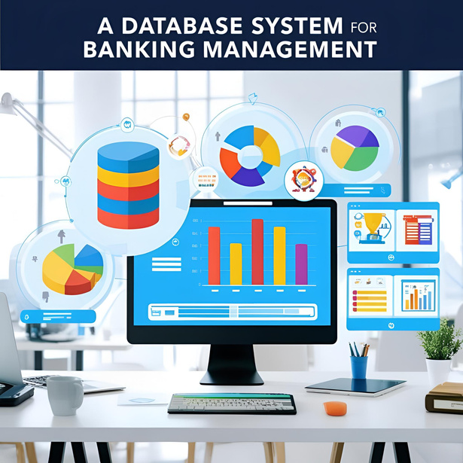
Database Design
Tables created include:
->`customers` to store customer details.
->`accounts` to link to customers.
->`transactions` linked to accounts.
->`users` for staff login details.
->Relationships define that customers
have multiple accounts and
accounts can have multiple transactions.

Slide 7

Stored Procedures
-InsertCustomer for adding new customers.
-InsertAccount for creating bank accounts.
-InsertTransactions for handling deposits and withdrawals.
-TransferAccount for transferring money between accounts.
-InsertLoan for adding new loan applications.
-LoginSystem for user authentication.

Slide 8
Functions and Triggers
-Function defined as: `getBalance(account_id)` to return the account balance.
-Trigger activated: `update_account` after a transaction to auto-update the balance.

Slide 9
Views
-AccountSummary view
->displays account ID, customer name, balance, and type.
-View_Total_Accounts_Customer
->shows the total number of accounts per customer.

Slide 10
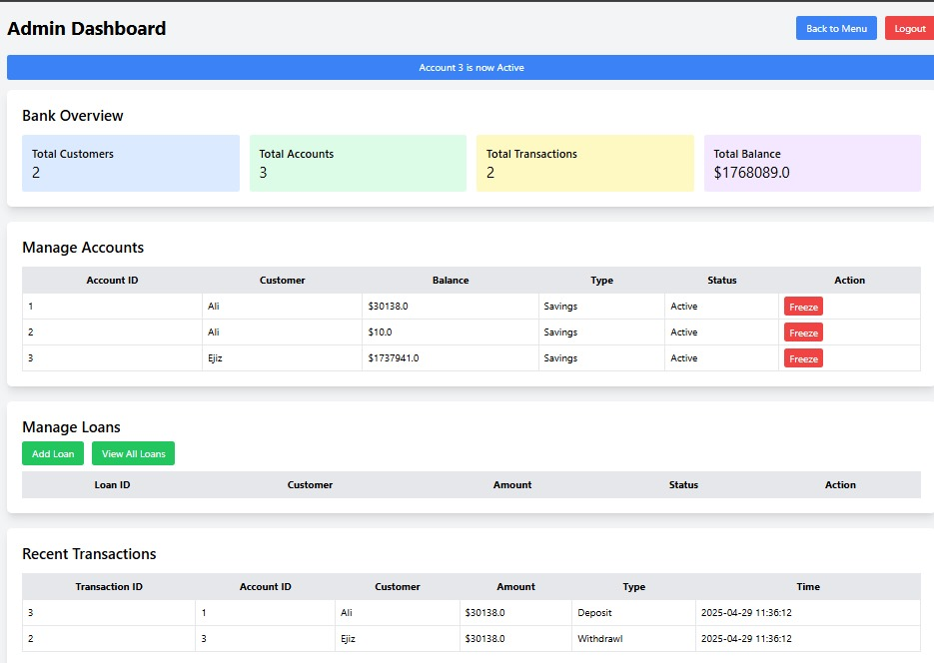

Slide 11
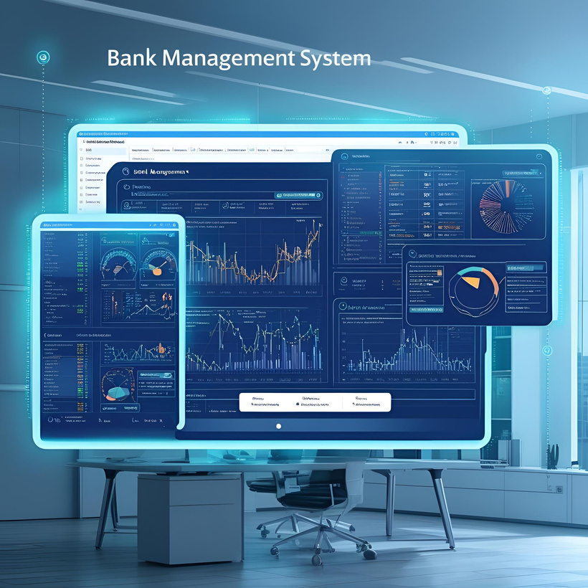
Challenges Faced
-Handling SQL exceptions gracefully.
-Linking Flask with MySQL stored
procedures.
-Managing user sessions securely.
-Displaying meaningful error and
success messages.

Slide 12

Future Improvements
-Implementing password encryption with hashing.
-Creating a responsive frontend with Bootstrap or React.js.
-Developing an admin dashboard for complete system control.
-Adding email and SMS notifications for transactions.
-OTP Verification for TransfersFor transferring money between accounts, add OTP (One-Time Password) via email or SMS.

Slide 13
Conclusion
Skills learned from this project include:
-> backend integration
-> database management
-> Flask web
->development, and exception handling
->practical experience in web

Slide 14
Thank you!

